Slide 1

TOPIC
VIEWER RETENTION IN OTT PLATFORMS
DIAGNOSING ENGAGEMENT PATTERNS

Slide 2


PROBLEM STATEMENT
The Business Challenge:
An OTT platform Despite having High viewership at launch, a significant portion of viewers disengage during Season 1.
Business Impact:
High churn limits User Lifetime Value (LTV) and creates uncertainty for content renewal decisions.
Internal Hypothesis:
Teams suspect content design (pacing, load, structure) is to the cause of the problem but there is a lack empirical evidence.
AIM:
Identify and diagnose the root cause of early viewer drop-off rate.
Recommend the actions the platform should take in order to improve the user engagement.

Slide 3

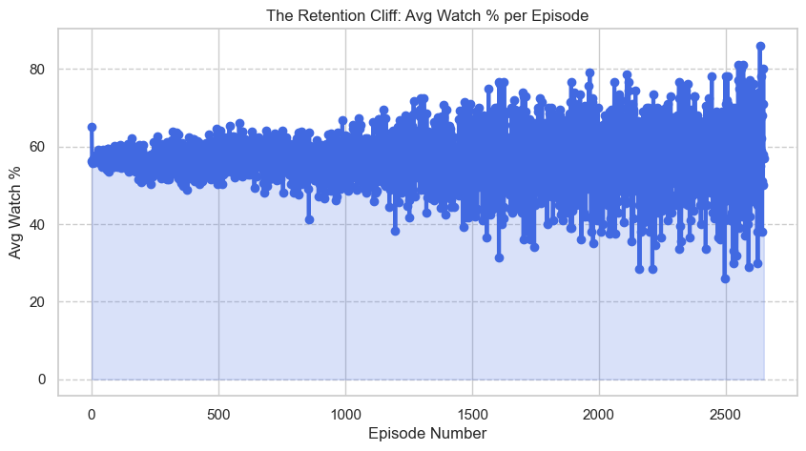
ANALYSIS OF THE "RETENTION CLIFF"
1
Non-Linear Decay: While many shows start with a watch percentage around 60%, the data shows extreme volatility as the episode number increases.
The Early Cliff: There is a clear concentration of data points at the beginning of the season (lower episode numbers) where retention is more stable, but it begins to fluctuate wildly thereafter.
2
Engagement Friction: The wide spread of data points at later episodes suggests that once a viewer's "cognitive capacity" is misaligned with the episode structure, watch time becomes highly unpredictable.
3
This chart visualizes the "Retention Cliff" pattern .
It plots the Average Watch % against the Episode Number

Slide 4

PACE VS COGNITIVE LOAD
PACE
COGNITIVE LOAD
Pacing refers to the narrative velocity—how quickly the story moves and how often significant plot points occur.
Cognitive Load refers to the mental effort required by the viewer to keep track of what is happening.
Low Pacing (1-4): Often called a "Slow Burn." These episodes take their time with character development, long atmospheric shots, and gradual world-building.
High Pacing (7-10): Fast-moving content. Think of an action thriller or a fast-paced sitcom where something new happens every few minutes.
Low Cognitive Load (1-4): "Mindless" or easy viewing. The plot is straightforward, there are few characters to remember, and the dialogue is simple.
High Cognitive Load (7-10): High-complexity content. This involves non-linear timelines (flashbacks/flash-forwards), many interconnected subplots, technical jargon, or a large "ensemble" cast.

Slide 5
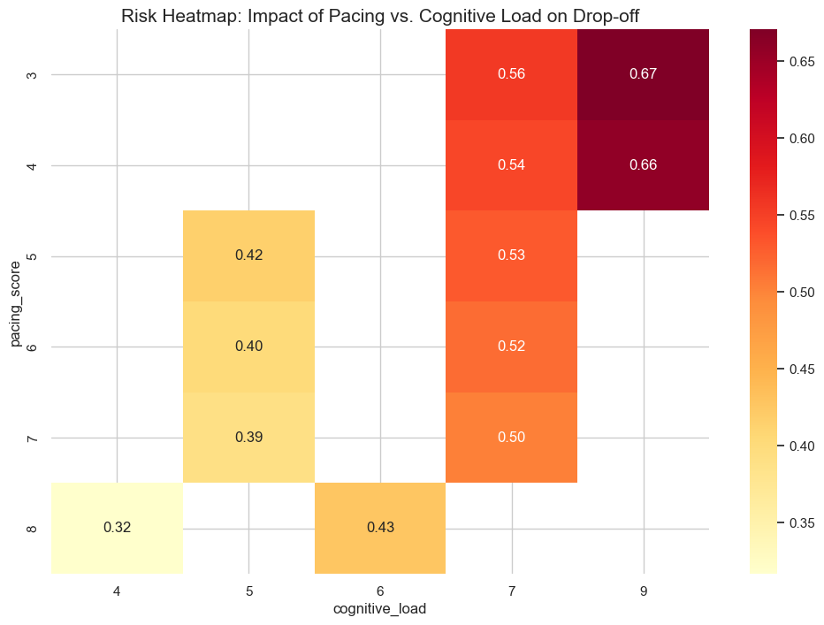
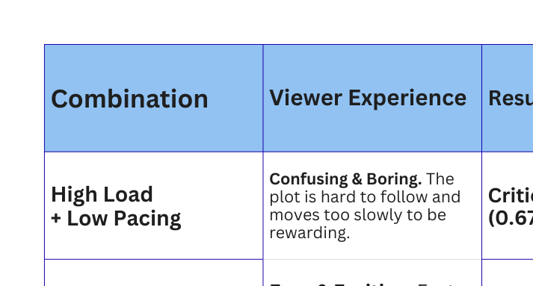
PACE VS COGNITIVE LOAD
KEY findings:

Slide 6

STRATEGIC RECOMMENDATIONS
Increase Narrative Velocity: For "Danger Zone" episodes (Pacing < 5), recommend tighter editing in the second act to increase the pacing score and maintain viewer momentum.
Strategic "Breather" Placement: Ensure that episodes with a Cognitive Load ‘ > 8 ‘ are followed by a "Balanced" episode to prevent viewer fatigue and cumulative drop-off.
Distribute Complexity: Work with showrunners to "unbundle" complex plot points (Cognitive Load) across multiple episodes rather than clustering them into one, reducing the risk of 0.67 drop-off probability.
Interactive Character/Plot Maps: Deploy a UI overlay for episodes with high cognitive_load (e.g., Sci-Fi or Thriller genres) to help viewers track complex subplots in real-time.
Friction-Triggered Recaps: If a viewer exceeds a specific pause_count or rewind_count threshold, the platform should offer an "Enhanced Recap" before the next episode to resolve confusion.
Optimized Auto-Play Timers: Shorten the transition time between episodes for shows in the "At-Risk" segment to leverage immediate curiosity and bypass the

Slide 7
PRODUCT DESIGN ENHANCEMENT SUGGESTION
Interactive Character/Plot Maps: Deploy a UI overlay for episodes with high cognitive_load (e.g., Sci-Fi or Thriller genres) to help viewers track complex subplots in real-time.
Friction-Triggered Recaps: If a viewer exceeds a specific pause_count or rewind_count threshold, the platform should offer an "Enhanced Recap" before the next episode to resolve confusion.
Optimized Auto-Play Timers: Shorten the transition time between episodes for shows in the "At-Risk" segment to leverage immediate curiosity and bypass the
Companion AI: Integrate an ai chatbot which gives extra information about characters and resolves doubts of the viewers with friendly interaction.

Slide 8
FUTURE-PROOFING & MEASURING IMPACT
1. Performance KPIs
3. Scalable UI Innovation
Target Risk Reduction: Aim to migrate "Danger Zone" episodes to a drop-off probability of 0.42 (the platform average).
Friction Benchmarks: Track a 15% reduction in rewind_count and pause_count following UI interventions.
A/B Testing: Launch the "Character Guide" overlay on a single high-complexity series to validate retention lift before a full rollout.
Dynamic Recaps: Develop automated recaps that lengthen or shorten based on a viewer's individual "Friction Score" (pauses/rewinds).
2. Pre-Production Modeling
4. Cultural Integration
Script Scoring: Implement a "Predictive Pacing Model" during the script phase to identify high-load episodes before filming.
Arc Distribution: Mandate a "Complexity Cap" per episode to ensure plot-heavy beats are distributed evenly across the season.
Creative Partnership: Position data insights as "Audience Advocacy" tools to help showrunners ensure their stories are understood.
Agile Post-Production: Shift toward a "Data-Led Edit" where early viewer data from the pilot informs the final cut of later episodes.

Slide 9

THANK YOU

